Slide 1

GemmaShield
AI Voice Scam Detection System for Elderly Protection
Developed by a First-Year CS Student
Notes:
大家好，今天我将向大家介绍我的项目——GemmaShield，一个旨在保护老年人免受AI语音诈骗的智能检测系统。随着AI语音克隆技术的发展，诈骗手段日益逼真，本项目致力于利用AI技术对抗AI犯罪，为弱势群体构建一道安全防线。

Slide 2

CONTENTS
01
02
03
04
Project Background
System Architecture
Experimental Journey
Application & Impact
剖析项目诞生的技术背景与行业痛点，阐述研发工作的核心动机与解决思路。
深度解析GemmaShield的整体技术架构，拆解核心防御组件与底层算法的逻辑实现。
回顾关键实验的完整执行过程，展示模型在多维度测试下的表现与突破性发现。
探讨技术落地的实际应用场景，评估其在AI安全领域产生的社会价值与未来潜力。
本次报告将围绕AI安全防御的核心命题展开。我们将从项目的初衷出发，通过技术架构的透视、实验数据的实证，以及应用前景的展望，为您呈现GemmaShield如何构建可靠的模型防线，以及这项技术在应对未来安全挑战中所蕴含的独特价值与深远意义。
Notes:
本次报告将分为四个部分。首先，我会介绍项目的背景和动机；接着，详细解析GemmaShield的系统架构与核心技术；然后，分享我们在实验过程中的发现，特别是关于模型鲁棒性的挑战；最后，展示项目的应用、社会影响以及未来的发展方向。

Slide 3







Project Background: The Rising Threat of AI Voice Scams
The Challenge
GemmaShield's Mission
Real-World Detection
Robust Defense
AI Voice Cloning
At-Risk Elders
Lab vs. Reality
Develop adaptive models that maintain high accuracy in everyday noisy settings, such as background TV, traffic, or distant phone calls.
Build systems resilient to adversarial voice manipulations and evolving deepfake techniques that bypass traditional filters.
Synthetic voices are now nearly indistinguishable from real humans, enabling hyper-realistic deception.
Older adults face significant risk due to reduced digital literacy and social isolation.
Benchmark success fails to translate to noisy, unconstrained real-world environments.
Explainable AI
Elder-Centric UX
Existing anti-fraud technologies are often calibrated for idealized data. This creates a critical vulnerability: scammers exploit the gap between controlled lab conditions and the messy, unpredictable nature of real human communication.
Demystify AI decisions for users and caregivers by providing clear, actionable insights into why a call is flagged as suspicious.
Design intuitive, low-barrier interactions that empower elderly users to easily verify call authenticity and seek help.
Notes:
我们正面临一个严峻的挑战：AI语音克隆技术的飞速发展，使得诈骗电话变得前所未有的逼真，尤其对老年群体构成了巨大威胁。现有的检测技术在实验室环境下表现优异，但在充满噪音和各种干扰的真实世界中却常常失灵。因此，GemmaShield应运而生，旨在弥合实验室与现实的差距，打造真正能保护弱势群体的AI安全系统。

Slide 4
Project Goals: What GemmaShield Aims to Achieve
Detect AI-generated Fake Voices
LLM Reasoning for Scam Risk
Elderly-Friendly Explanations
Identify synthetic voices generated by advanced AI models. This foundational capability blocks the primary vector of voice impersonation scams before they reach the end-user.
Leverage large language models to analyze conversational context and intent. This dynamic assessment goes beyond keywords to evaluate the probabilistic risk of a fraudulent attempt.
Generate clear, jargon-free risk explanations tailored for senior users. Empower vulnerable populations to understand "why" a call is suspicious, enabling informed decision-making.
Benchmarking Real-World Robustness
Multimodal AI Security Fusion
Investigate the gap between controlled lab performance and the challenges of real-world deployment, such as varying audio quality, background noise, and dialect diversity. This research ensures the system remains effective outside idealized testing environments.
Integrate voice biometrics with text analysis, caller metadata, and behavioral patterns for a layered defense system. By combining multiple data modalities, GemmaShield creates a more resilient barrier against evolving AI-powered fraud tactics.
Notes:
GemmaShield的目标非常明确。首先，它要能准确检测出AI生成的伪造声音。其次，通过LLM的推理能力，分析通话内容，判断诈骗风险。更重要的是，它要能为老年人提供易于理解的解释，告诉他们为什么这个电话可能有危险。同时，我们也致力于研究模型在真实世界中的鲁棒性，并探索多模态AI安全系统的潜力。

Slide 5
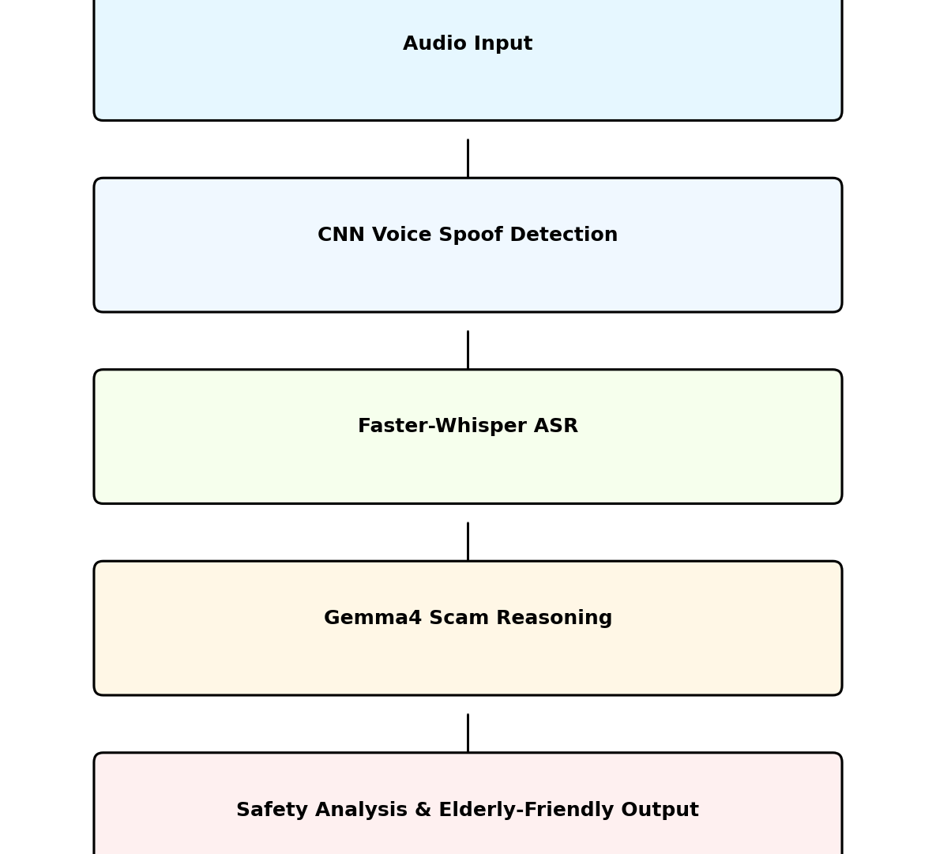



System Architecture: A Multimodal AI Pipeline
Audio Sensing & Preprocessing
Dual-path input handling: The raw audio stream is simultaneously fed into a CNN model for real-time voice spoof detection and a Faster-Whisper ASR model for high-accuracy speech-to-text conversion, capturing both acoustic and linguistic features.
Multimodal Gemma4 Inference
Context-aware fusion engine: Combines the spoof probability score with the transcribed text context. The Gemma4 LLM performs deep semantic reasoning to identify scam patterns, emotional manipulation tactics, and logical inconsistencies within the dialogue flow.
Elderly-Centric Safety Output
Actionable insights generation: Translates complex AI analysis into a simplified, human-readable safety report. Highlights red flags, summarizes the call's intent, and provides clear, actionable warnings tailored for the elderly population.
Notes:
这是GemmaShield的系统架构图。整个流程是一个多模态AI管道。首先，音频输入被送入CNN模型进行语音伪造检测。同时，音频也会通过Faster-Whisper进行语音识别，转换成文本。然后，语音伪造的概率和文本内容一起被送入Gemma4进行推理分析。最后，系统生成一份对老年人友好的安全分析报告。

Slide 6
Core Technologies
Voice Spoof Detection
Speech Recognition
AI Reasoning & Analysis
CNN (Convolutional Neural Network)
Faster-Whisper Model
Google Gemma4 LLM
精准识别音频中的数字合成特征，有效检测语音是否为AI伪造，构筑第一道声音安全防线。
基于优化的Transformer架构，将原始语音流高效、高准确率地转换为可分析的文本数据，支持实时处理。
利用大模型的语境理解能力，深度分析文本语义，精准识别诈骗话术特征与逻辑陷阱，提供风险预警。
Interactive Frontend
Cloud Deployment
Audio Feature Extraction
Gradio Web Framework
HuggingFace Spaces
Log-Mel Spectrogram
快速构建轻量级、功能完备的Web交互界面，支持用户上传音频、实时调用模型并直观查看检测结果。
基于容器化技术的一站式部署平台，实现模型的快速上线、弹性伸缩与全球可访问的在线演示服务。
将时域音频信号转换为符合人类听觉感知的频域特征图，为CNN模型提供高质量的输入数据以进行模式识别。
Notes:
我们的系统集成了多种前沿技术。核心的语音伪造检测由CNN模型完成，它通过分析Log-Mel频谱图来判断声音真伪。Faster-Whisper负责高效地将语音转为文字。Google的Gemma4大语言模型则扮演了智能分析师的角色，对文本内容进行深度推理。整个前端由Gradio构建，并部署在HuggingFace Spaces上，方便用户访问。

Slide 7
CNN Voice Spoof Detection: Benchmark Performance
Training Setup
Key Performance Metric (EER)
Model Backbone
ASVspoof Dataset
≈ 0.00134
CNN architecture trained on raw spectrogram features, optimized for capturing subtle audio anomalies in voice signals.
Leveraging ~110,000 high-quality clean training samples to establish a robust baseline for generalization across spoofing attacks.
This ultra-low Equal Error Rate demonstrates near-perfect spoof detection capability under ideal, controlled laboratory conditions, setting a new benchmark for precision.
Validation of Core Detection Capabilities
The benchmark results validate the CNN model's efficacy in identifying synthetic voice manipulations. With an EER this close to zero, the system establishes a high-confidence foundation for real-world deployment, where it can reliably distinguish between genuine human voices and sophisticated AI-generated spoofs under pristine audio conditions.
Notes:
我们的核心检测模型是一个CNN网络。在训练阶段，我们使用了包含约11万个干净样本的ASVspoof数据集。在标准的基准测试中，模型表现非常出色，等错误率（EER）低至0.00134，这表明在理想的实验室环境下，它几乎可以完美地检测出伪造语音。

Slide 8
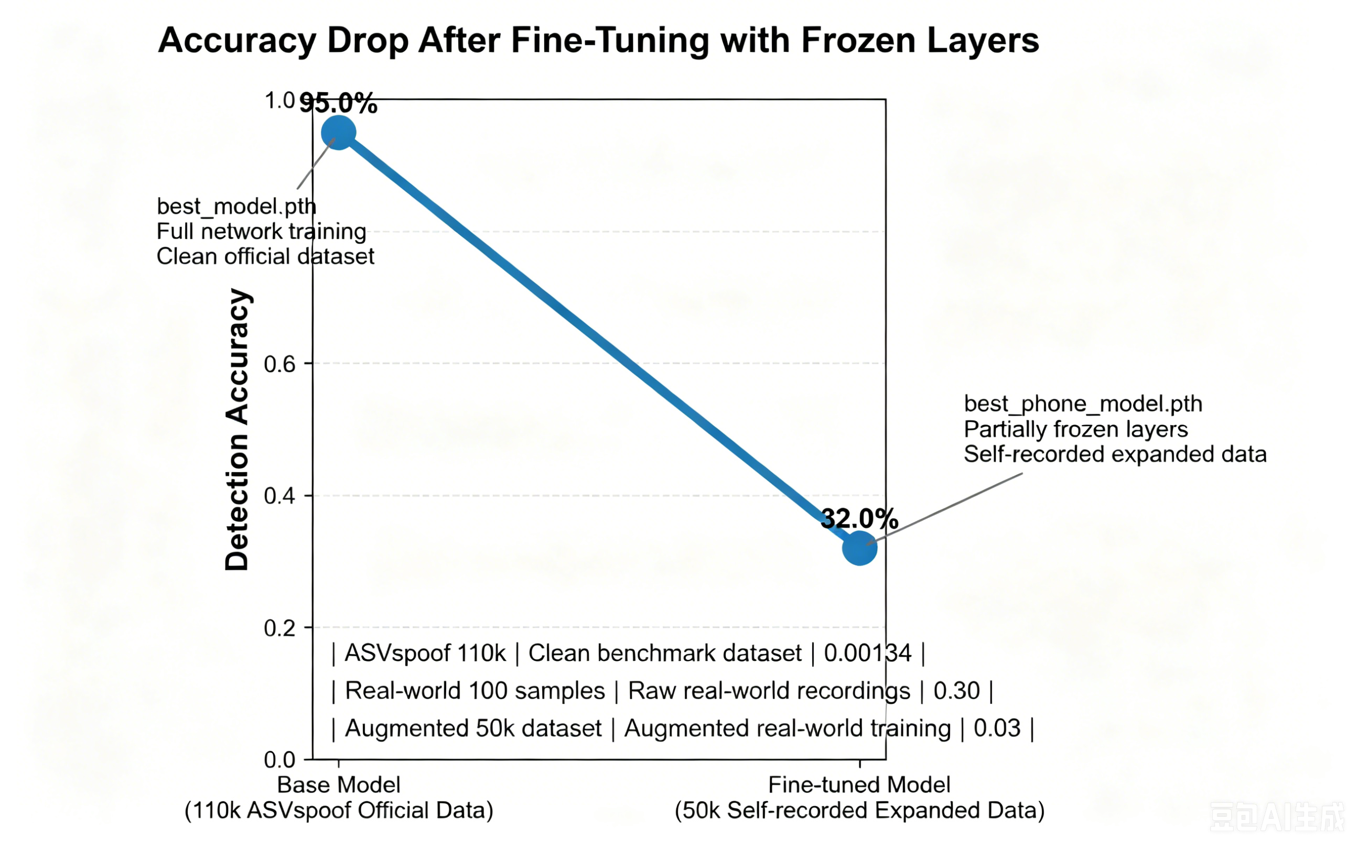
The Reality Check: Real-World Dataset Problem
核心问题：严重的领域断层 (Domain Gap)
模型在实验室受控环境中表现优异，但在面对真实世界音频时性能急剧下滑。这揭示了训练数据与实际应用场景之间存在难以忽视的领域差异，导致模型无法有效泛化。
真实世界数据集：100+ 高挑战性样本
为复现真实挑战，我们手动采集了包含环境噪音、电话通话音质、低码率压缩语音、重放攻击以及不同麦克风硬件差异的混合数据集，全面模拟了用户在非理想条件下的使用情况。
EER ≈ 0.30| 模型泛化能力临界值
实测警示：性能显著退化
图表清晰地描绘了从纯净实验室数据到复杂真实场景的性能轨迹。这一显著的准确率下跌（从95.0%降至32.0%）不仅是一个负面结果，更是我们后续构建增强数据集、优化鲁棒性算法的关键起点。
直接在该真实小样本集上训练后，模型的等错误率（EER）飙升至约 0.30，这一数据直观地量化了当前技术在实际落地前必须解决的核心障碍。
Notes:
然而，现实给了我们一记警钟。当我们将模型应用于真实世界的录音时，性能急剧下降。我们手动收集了约100个包含噪音、电话音质、压缩等各种复杂情况的真实样本，直接训练后，模型的EER飙升到了0.30。这张图表清晰地展示了实验室数据与真实世界数据之间存在巨大的领域差异。

Slide 9
Data Augmentation & Transfer Learning
Custom Augmentation Pipeline
Transfer Learning Strategy
从100个稀缺原始样本扩展至约 50,000 个高质量增强样本，构建丰富的声学特征空间。
复用在 110k ASVspoof 大规模公开数据集上预训练的 CNN 模型，降低从头训练的成本。
核心技术：随机噪声注入、动态音调偏移、波形扰动与复杂环境下的重放攻击模拟。
执行策略：冻结特征提取层，仅对上层全连接网络进行微调，适配目标数据集分布。
关键性能突破 (EER)
原始数据
数据扩增
模型适配
≈ 0.03
100 Real Samples
→ 50k+ Variants
Finetuning CNN
通过“小样本扩增 + 预训练迁移”的组合策略，有效解决了数据稀缺带来的过拟合问题，实现了高精度的声学特征识别。
显著优于传统小样本训练基线模型
Notes:
为了解决数据量不足的问题，我们设计了一套自定义的数据增强流程，通过添加噪音、改变音调、模拟重放等方式，将100个真实样本扩充到了约5万个。接着，我们采用了迁移学习策略，利用在ASVspoof上预训练好的模型，冻结部分层后，在增强后的数据集上进行微调。这一系列操作显著提升了模型性能，将EER降低到了0.03。

Slide 10
Key Robustness Finding: The Illusion of Low EER
Critical Discovery
The Overfitting Issue
An extremely low benchmark EER score does not inherently guarantee real-world robustness. Our tests revealed a significant disconnect between controlled lab performance and the model’s ability to handle unforeseen adversarial inputs in practical applications.
Post fine-tuning, the model excelled at recognizing genuine speech characteristics within our augmented dataset. However, it failed catastrophically when challenged with unseen real-world fake voices, as it had memorized dataset-specific patterns rather than learning generalizable spoof detection.
The Core Problem
Current Deployment Strategy
The fundamental flaw was that the model learned to identify superficial "realness" cues from the training data, rather than mastering generalized spoof patterns. This meant it could not adapt to novel voice cloning techniques or synthetic speech variations encountered in the wild.
To mitigate this risk, we have discarded the problematic real-world fine-tuning phase. The deployment plan now relies on the cleaner, more robust ASVspoof-trained baseline model, prioritizing generalization and long-term stability for real-world voice authentication scenarios.
Notes:
这个项目最重要的发现之一是：极低的基准测试EER并不能保证真实世界的鲁棒性。我们发现，微调后的模型虽然EER很低，但它只是学会了识别我们增强数据集中的“真实感”特征，而不是真正学会了泛化的伪造模式。当遇到新的、未见过的伪造语音时，它的表现依然不佳。因此，我们最终决定放弃有问题的微调，回归到泛化能力更强的基准模型进行部署。

Slide 11
Gemma4 Integration: From Classifier to AI Safety Assistant
Traditional Classifiers
Gemma4 Input Engine
AI Safety Assistant
Outputs only a cold, binary probability score (e.g., 97% real). It lacks context and fails to answer the user’s most critical question: “Why is this a risk?”
A sophisticated pipeline that fuses raw call data with analytical signals, providing the LLM with the full context needed for accurate reasoning.
Transforms raw data into a human-centric advisory. The model now acts as a proactive guardian, not just a passive detector.
Limitations:No actionable guidance. Users receive a score but no steps to protect themselves.
Data Fusion:Raw transcript + Spoof probability + Contextual red flags (urgency, payment requests).
Actionable Insight:“Verify identity via a trusted channel. This caller exhibits scam indicators.”
THE PARADIGM SHIFT: FROM “CLASSIFIER” TO “ASSISTANT”
By integrating Gemma4, we’ve transcended the limitations of traditional machine learning models. The system no longer just reports a risk score—it explains the risk in natural language and provides clear, real-time steps for the user to take. This evolution marks the transition from a technical tool into a proactive AI Safety Assistant that empowers users to make informed decisions and avoid financial harm.
Notes:
Gemma4的集成是本项目的点睛之笔。传统的检测系统只会给出一个冰冷的概率分数，用户无法理解背后的原因。而GemmaShield通过结合语音识别文本和伪造概率，让Gemma4进行推理，生成如“诈骗可能性：中等，建议：汇款前核实对方身份”这样通俗易懂的建议。这使得我们的系统从一个简单的“分类器”升级为一个真正的“AI安全助手”。

Slide 12



Elderly-Friendly Design: Accessibility is Key
Core Design Philosophy
The goal is not only to ensure accurate detection of potential risks, but more importantly, to empower elderly users by clearly explainingWHYa voice or interaction might be dangerous. We aim to build trust through transparency, making technology a supportive tool rather than a confusing barrier.
Simple Controls
Bilingual UI
Large Fonts
Clear AI Logic
High-contrast, oversized typography eliminates visual strain. Text elements are scaled for effortless readability, catering to users with age-related vision changes without sacrificing information density.
Redesigned UI components with increased touch targets and reduced interaction steps. Every button and action is purposeful, minimizing the chance of errors and making navigation feel intuitive and stress-free.
Seamless switching between Chinese and English. This dual-language support bridges communication gaps, ensuring that non-native speakers or users more comfortable with their mother tongue can fully engage with the system.
AI outputs translated into plain, conversational language. Complex technical judgments are broken down into simple "why" explanations, empowering users to understand and trust the system's recommendations.
Notes:
由于系统的目标用户是老年人，易用性是我们设计的重中之重。我们不仅追求检测的准确性，更希望帮助老年人理解风险所在。因此，我们的界面采用了大字体、简化的按钮、中英双语支持以及清晰易懂的AI解释。我们的目标是让科技真正服务于老年人，而不是成为他们的负担。

Slide 13







Features Overview
Voice Spoof Detection
AI Scam Reasoning
Whisper Transcription
精准识别合成语音与录音攻击，构建第一道声纹安全防线，有效拦截伪造身份的恶意语音接入。
基于大模型的意图推理引擎，实时分析对话逻辑与话术特征，快速识别潜在的诈骗诱导与陷阱。
集成优化版 Whisper 模型，实现毫秒级语音实时转写，将音频流转化为可解析的文本数据，辅助决策。
Gemma4 Explanation System
Elderly-Friendly UI
Chinese / English Support
提供可解释的 AI 决策依据，不仅输出风险预警，更能回溯分析逻辑，让用户清晰了解风险产生的根源。
专为老年群体设计的无障碍交互界面，采用大字体、高对比度与简化操作流程，降低数字鸿沟带来的风险。
原生支持中英文双语实时处理与交互，无论是境内的方言变体还是跨境的语音交流，均能保持高精度识别。
HuggingFace Deployment
Real-time Audio Upload
CPU-Compatible Deployment
无缝部署于 Hugging Face 生态，支持模型即服务的快速调用与云端集成。
低延迟流式音频传输技术，确保录音与分析的同步性，不错过任何关键语音片段。
极致模型轻量化优化，无需高性能 GPU，普通 CPU 即可流畅运行，降低落地门槛。
Notes:
总结一下，GemmaShield集成了语音伪造检测、AI诈骗推理、语音转文字、可解释系统、老年友好界面、双语支持等一系列核心功能。它已经成功部署在HuggingFace上，支持实时音频上传，并且经过优化，可以在CPU环境下运行，保证了广泛的可用性。

Slide 14

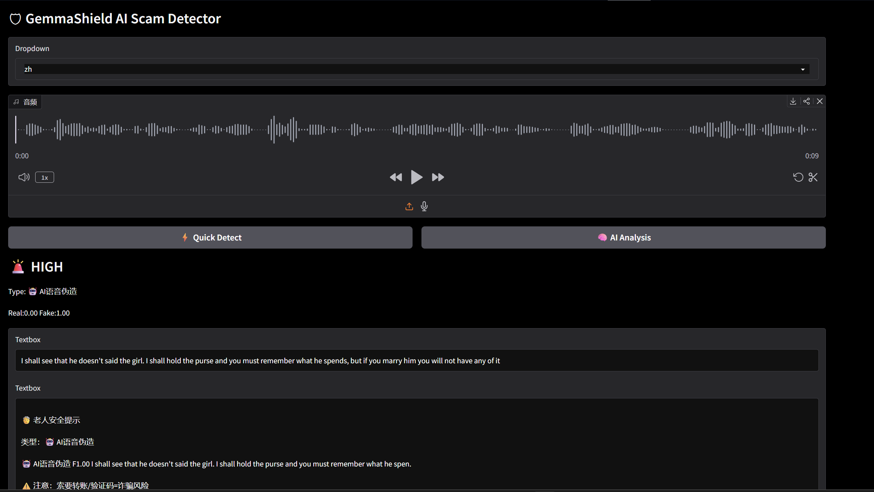



Online Demo: Try it Yourself!
Access the Live Demo Space
huggingface.co/spaces/Laura-smith/voice-spoof-detector
Real-time Detect
Auto-Transcript
Gemma4 AI
Dual-Language
Upload audio and get instant deepfake risk assessment.
Convert speech to text for easier content verification.
Advanced LLM analysis of audio patterns.
Supports Chinese and English interactions.
User-Centric Interface
Optimized for CPU Deployment
The intuitive web interface empowers users to upload audio files and trigger deepfake detection with a single click. Featuring real-time waveform visualization and a comprehensive multi-dimensional analysis report, it demystifies the AI anti-fraud process, making the results transparent, understandable, and actionable for end-users.
To ensure smooth operation on HuggingFace's shared CPU instances, we've implemented Gemma4 lazy loading, enabled lightweight Whisper transcription mode, and applied CPU-safe inference optimizations. This balances high accuracy with fast response times even under resource constraints.
Notes:
大家可以通过这个链接访问我们的在线演示。这个演示支持上传音频文件进行实时检测，并能生成文字记录和Gemma4的分析报告。为了在HuggingFace的CPU限制下保证稳定运行，我们做了大量优化，比如对Gemma4进行懒加载，并启用了轻量级的Whisper模式。

Slide 15


Research Significance
AI Security & Safety
Voice Spoof Detection
Human-centered AI
Proactively combating emerging adversarial threats to fortify the trustworthiness of AI systems in high-stakes environments.
Going beyond lab benchmark scores to focus on real-world robustness against unseen synthetic voices and environmental noise.
Prioritizing the design of accessible and ethical AI technologies that protect and empower vulnerable populations.
Explainable AI (XAI)
Multimodal AI Systems
Critical Insight
Demystifying black-box decision-making processes to provide transparency, allowing stakeholders to understand and trust AI outputs.
Integrating audio, textual, and contextual data streams to create synergistic defenses against sophisticated multi-vector attacks.
Real-world security requires more than just low error rates.Generalization and adaptabilityare the unsolved pillars that determine the success of AI deployment.
Achieving low benchmark EER alone is insufficient for real-world deployment. The project underscores thatRobustness and generalizationremain critical open challenges, demanding continuous innovation to bridge the gap between lab performance and real-world resilience.
Notes:
本项目的研究意义在于，它不仅是一个应用，更探索了AI安全、语音伪造检测、以人为本的AI设计、可解释AI以及多模态系统等多个前沿研究方向。我们最重要的结论是：仅仅追求低基准测试错误率是远远不够的，模型的鲁棒性和泛化能力才是决定其能否在真实世界中发挥作用的关键。

Slide 16
Future Work
Stronger Robustness Training
Adversarial Spoof Detection
Replay Attack Defense
Develop more sophisticated training methodologies to handle unseen fake voice patterns. This involves exposing the model to diverse synthetic audio datasets to enhance its resilience against emerging and previously unknown deepfake generation techniques.
Investigate the vulnerabilities of voice recognition systems to adversarial perturbations. Build proactive defense mechanisms that can identify and neutralize subtle, human-imperceptible modifications designed to bypass authentication or classification safeguards.
Refine algorithms to accurately detect voice recordings played over speakers in complex acoustic environments. Improve the system’s ability to distinguish between live human speech and replayed audio, even when masked by background noise or reverberation.
Multilingual Scam Analysis
Streaming Phone-Call Analysis
Edge-Device Optimization
Extend the detection framework to support multiple languages and regional dialects. Adapt the core model to recognize cultural and linguistic nuances in fraudulent speech patterns, enabling effective scam identification across global communication networks.
Implement low-latency, real-time processing capabilities for live phone call streams. This feature allows for the dynamic monitoring and interception of suspicious activities during ongoing conversations, providing immediate alerts to prevent potential harm.
Optimize the AI model for lightweight deployment on resource-constrained hardware such as smartphones and IoT devices. Reduce computational overhead while maintaining high accuracy, enabling offline detection capabilities without relying on constant cloud connectivity.
Notes:
展望未来，我们还有很多工作要做。包括开发更强的鲁棒性训练方法、研究对抗性攻击的防御、提升对重放攻击的检测能力、支持多语言分析，以及实现实时通话分析和边缘设备部署。这些都是我们希望在未来继续探索的方向，以构建一个更安全、更智能的语音反欺诈系统。

Slide 17

Social Impact: Using AI for Social Good
Core Motivation
Future Importance
Project Submission
GemmaShield was born from a deep social-good motivation: to deploy AI as a force for protection. Our goal is to shield elderly users from the rising tide of AI voice scams—sophisticated attacks that weaponize familiarity and trust to defraud vulnerable populations.
As AI voice cloning becomes more accessible and realistic, proactive defense systems like GemmaShield are critical. We envision this as a cornerstone of future digital safety infrastructure, providing scalable, adaptive protection for individuals and communities against evolving synthetic media threats.
Complete Source Code Repository
5-Minute System Demo Video
Comprehensive Technical Report
Our mission is to transform cutting-edge AI technology into a shield for society. By combining technical innovation with ethical responsibility, we aim to build a safer digital future where technology empowers protection, not exploitation. GemmaShield is more than a project—it is a blueprint for how AI can be harnessed to defend the most vulnerable members of our community against emerging digital threats.
Notes:
最后，我想强调GemmaShield的社会价值。这个项目的初衷就是利用AI技术为社会公益服务，保护老年人免受日益猖獗的AI语音诈骗。随着AI技术的不断进步，我们相信这类安全系统将成为未来数字安全基础设施的重要组成部分。本次提交包含了完整的源代码、演示视频和技术报告。

Slide 18

Thank You
Q & A
Notes:
我的报告到此结束，感谢大家的聆听。现在是问答环节，欢迎大家提问。

